Slide 1

Common Chart Types and Use Cases
Pie & Donut Charts
Scatter & Bubble Charts
Box & Whisker Charts

Slide 2
The Practice Excel File
In this section, open the “Excel-Part 3.xlsx” file and generate plots for each sheet.

Slide 3
Pie & Doughnut Charts
Used for: Comparing proportions totaling 100%.
Examples:
Budget breakdown by department
Website traffic sources
Pro Tips:
Limit slices to six or fewer for readability.
Use donut charts for multi-series comparisons.

Slide 4
Practice: Pie Chart
Sheet name on the Excel file: Pie Charts
Select the First and Second Column
Go to the Insert tab and select Pie Chart.
Adjust the chart title and the axis tick size as needed.
Select 2D Pie
Notes:
Go to the Insert tab and select Line Chart.

Slide 5
Practice: Hardware Expenses
Notes:
Go to the Insert tab and select Line Chart.

Slide 6
Practice: Doughnut Chart
Sheet name on the Excel file: Area Charts
Select the First and Second Column
Go to the Insert tab and select Pie Chart.
Adjust the chart title and the axis tick size as needed.
Select Doughnut Chart
Notes:
Go to the Insert tab and select Line Chart.

Slide 7
Practice: Hardware and Salaries Expenses Comparison
Notes:
Go to the Insert tab and select Line Chart.

Slide 8
Scatter Charts
Used for:
Visualizing the relationships or correlation between two variables.
Identify trends, clusters, and outliers.

Slide 9
Practice: Scatter Plots
Sheet name on the Excel file: Scatter Charts
Select Column B (Monthly Users) and C (Revenue)
Go to the Insert tab and select Scatter Chart.
Go to the trendline settings and display equation and R-Squared
Right click on the data and select Add Trendline
Notes:
Go to the Insert tab and select Line Chart.

Slide 10
Practice: Monthly Users vs. Revenue Scatter Chart
Notes:
Go to the Insert tab and select Line Chart.

Slide 11
🫧 What is a Bubble Chart?
Definition:
A bubble chart is a variation of a scatter plot where each point also has a size (bubble radius) representing a third variable.
Example Use:
Comparing cities by population (size), income (X), and life expectancy (Y).
Steps to generate in Excel:
Follow the same steps as for a scatter plot, but choose 'Bubble Chart' from the Insert tab instead.

Slide 12
Practice: Monthly Users vs. Revenue Bubble Chart
Notes:
Go to the Insert tab and select Line Chart.

Slide 13
Box and Whisker Charts
Components of a Box and Whisker Chart:
Box:
Interquartile Range (IQR): The box spans from Q1 to Q3, representing the middle 50% of the data.
Median: A line inside the box indicates the median (Q2) of the dataset.​
Whiskers:
Lines extending from the box to the minimum and maximum values within 1.5 times the IQR from Q1 and Q3, respectively.
Outliers:
Data points beyond the whiskers are considered outliers and are often plotted as individual dots.

Slide 14
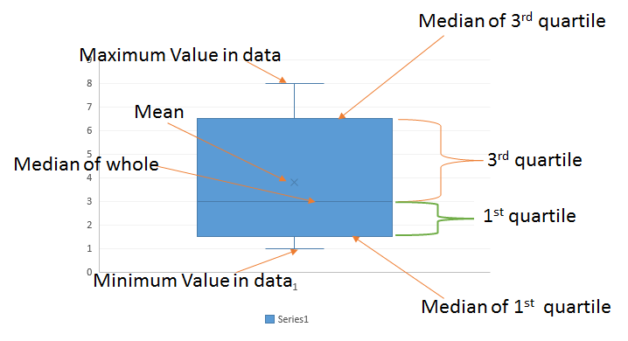
Components of a Box and Whisker Chart:

Slide 15
Practice: Test Scores Grouped by Subject
Sheet name on the Excel file: Box Plots
Select the Subject and Test Score Columns
Go to the Insert tab and select Box Plots.
Adjust the chart title and the axis tick size as needed.
Notes:
Go to the Insert tab and select Line Chart.

Slide 16
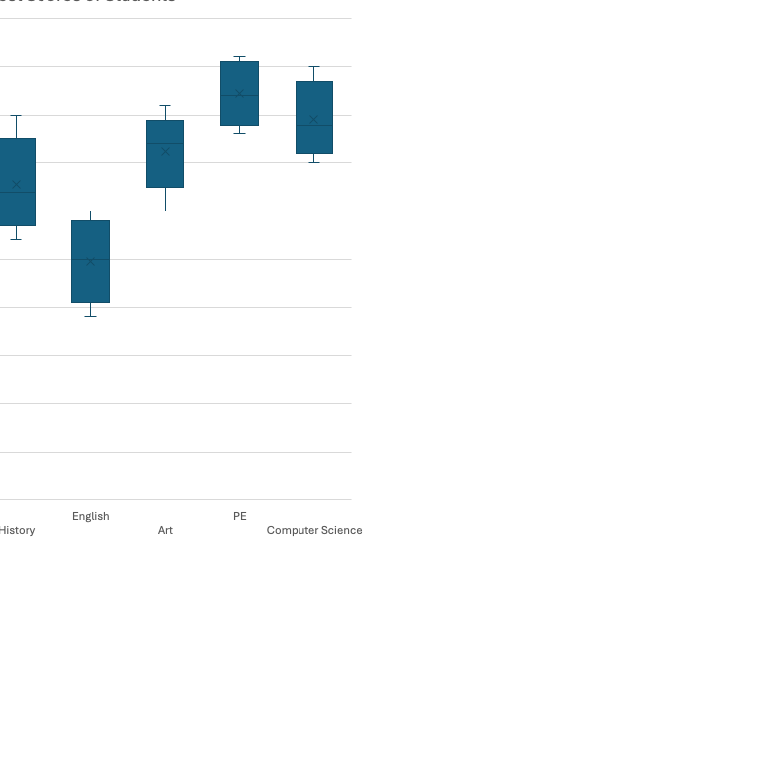
Practice: Test Scores Grouped by
Notes:
Go to the Insert tab and select Line Chart.

